Slide 1
Using Dance Performance to Portray Drug Addiction
By: Rachel Wells

Slide 2
What is Addiction? What are the signs?
Addiction: a need, both physical and psychological, to continue the use of a substance, regardless of its effects
Signs of an addiction:
Intense cravings for the substance
Decrease in social interaction
Pushing off responsibilities (work)
Mood swings
Needle marks (if injecting the drug)

Slide 3
Why is it important?
Impacts the functioning of the brain!
Changes the way the brain feels and perceives pleasure
Impairs the functioning of neurotransmitters – used to communicate messages between brain and body
Can change the shape/physical structure of neurons in the brain
Real danger is how quickly one becomes addicted

Slide 4
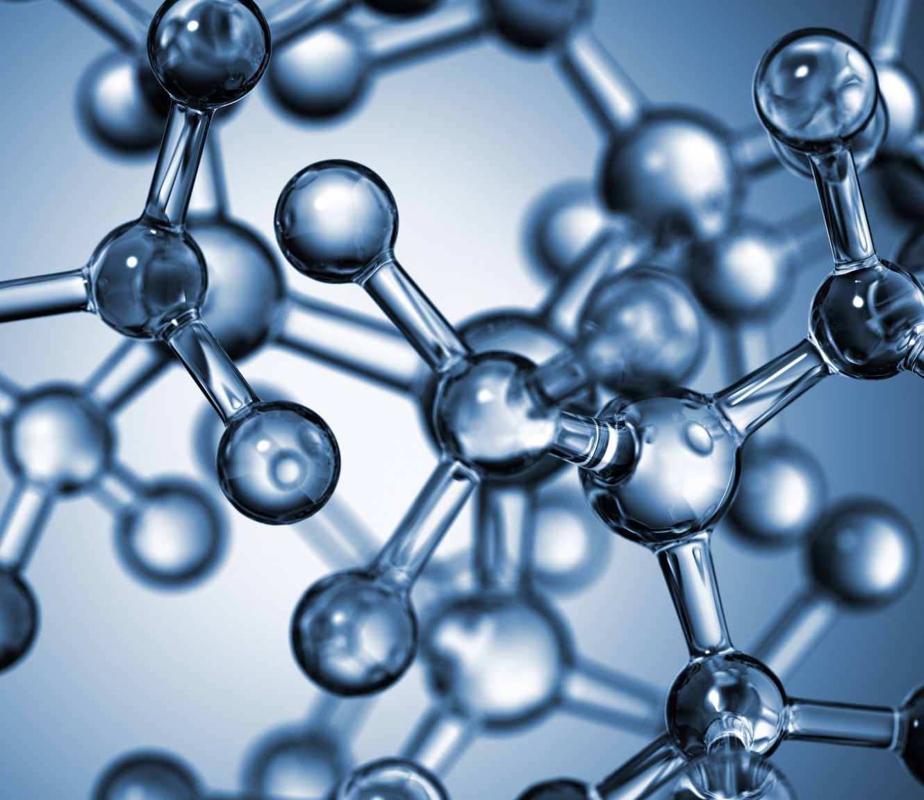
Causes of Addiction
Genetic
Genetic predisposition to addictive behaviors
Can delay or speed up disease progression
Environmental
Family beliefs and attitudes about drug use
Exposure to peer groups that support/encourage use
Daily/life stressors

Slide 5
Importance of art to discuss addiction
More effective than other programs like D.A.R.E
Many state that they would prefer hearing from a recovered addict
People want a more in depth and personalized understanding
Choose art!
Combines factual evidence with something visual
Makes it an easier topic to digest
Better for starting conversations about drug addiction
Provides a more “complete” view of what addicts experience

Slide 6
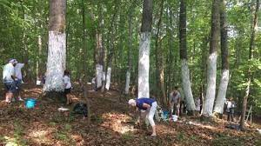
Example!
Outdoor exhibition by Gary Perlow
50 recovering/recovered addicts accompanied by friends and family
Painted trees white to mark the level of their recovery
Done to showcase “the other side” of addiction – recovery!
Often only see the dark side of addiction BUT recovery is possible!

Slide 7
Creating “The Road to Addiction Recovery”: Preparation
Research
Before starting choreography, each performer was required to conduct extensive research including;
Warning signs of addiction
Physical and psychological impacts of drug use
Statistics of drug related deaths and the overall reach of substance use on society
Impact of drug addiction on those around the addict (family and friends)
Resources that can provide help for addicted individuals and their loved ones
Important in giving an accurate portrayal of addiction
Allowed for us to better understand addiction as a whole and portray our characters correctly
Important for avoiding the use of stereotypes
Allowed for us to better advocate for those struggling with addiction

Slide 8
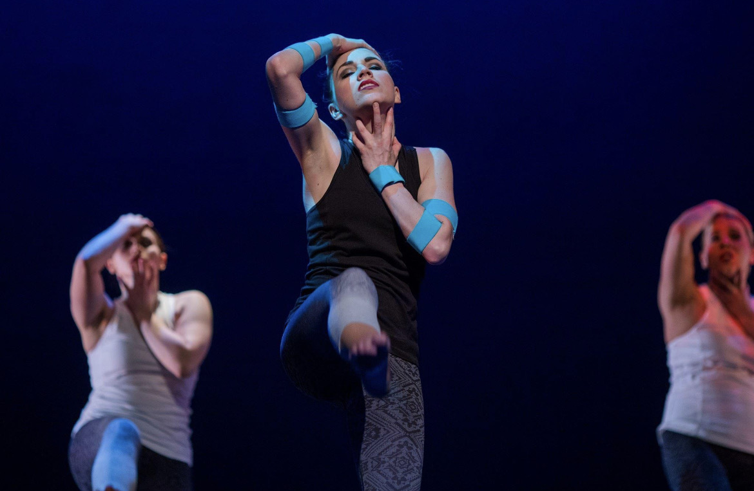
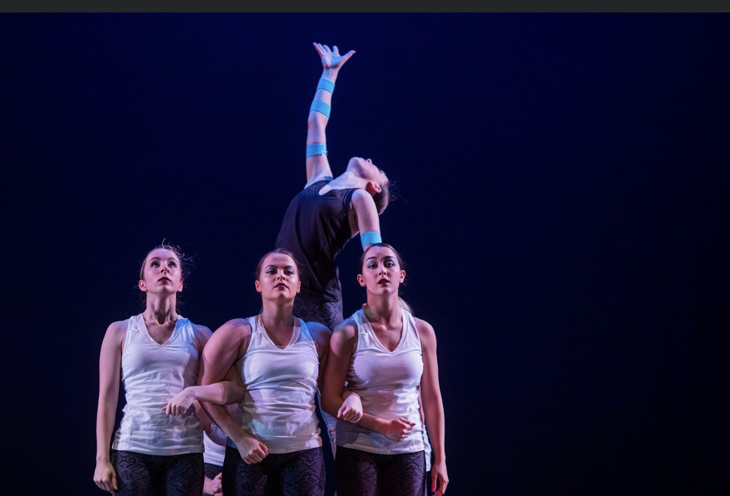
Creating “The Road to Addiction Recovery”: Costuming
Lead dancer
Dark clothing – sets her apart as the one with the addiction, hints at the “darker” parts of addiction
Teal bands – represent her addiction and her dependence on a substance
Also the color for drug addiction awareness and recovery
Ensemble dancers
Lighter top – cleanliness, absence of addiction, “angel” like
Represent the family/friends of the addict

Slide 9
Creating “The Road to Addiction Recovery”: Choreography
Story behind the piece
Shows an addicted individual struggling to overcome their addiction with the help of their loved ones
Movement
In the beginning movement consists of the lead dancer being held up and lifted
Represents dependence on the substance and inability to support oneself
Quick, heavy movement of ensemble dancers
Represents anger, frustration, sadness, etc. felt by loved ones of addicted individual
Movement as a group
Represents the ability to support and love someone through the recovery process

Slide 10
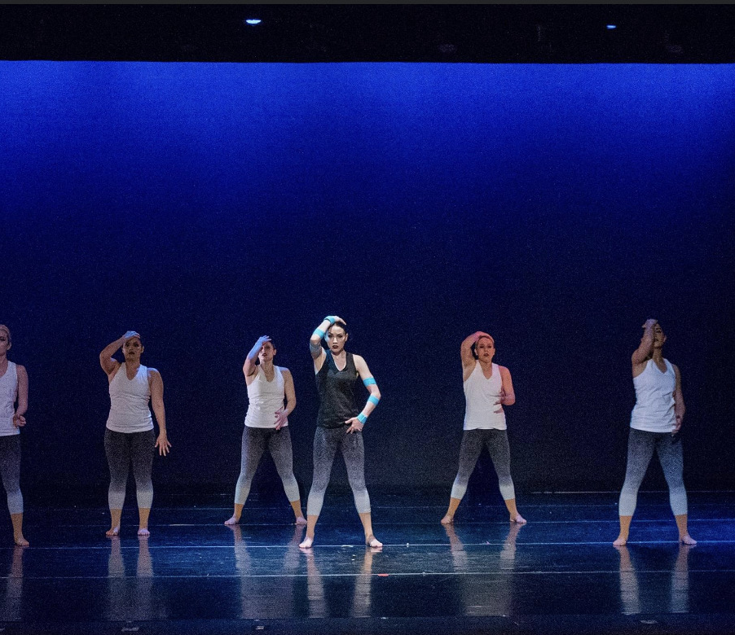
“The Road to Addiction Recovery”
https://www.youtube.com/watch?v=p0AZPL-HgdM

Slide 11
Resources
Cambest, M. (2017). Outdoor art installation to showcase the ‘other side’ of addiction. Capital Gazette. https://www.capitalgazette.com.
Santora, B. P., Dowell, L. M., and Henningfield, E. J. (2011). Art and Addiction: Putting a human face on addiction and recovery. www.addictionandart.org.

